Slide 1
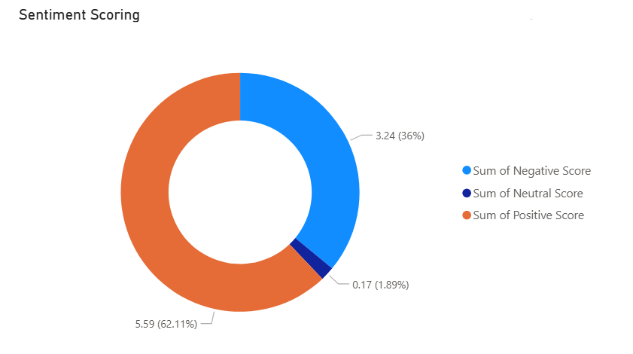
Sentiment DashBoard
Seneca College – CSP451NIA
Region: Canada East
Date: November 7, 2025
Nicholas Narsa

Slide 2

overview
This concept demonstrates how the sentiment dashboard interprets user reviews via Azure Cognitive Services Text Analytics
Core Components
Azure Cognitive Services Text Analytics: Interprets user text for key phrases and sentiment scoring
HTTP Trigger: User submitting a review via webpage
Cosmos DB: Stores key phrases and scoring
Power BI: Displays Key Information

Slide 3
Endpoints
Language Service: https://nnarsa-presentation.cognitiveservices.azure.com/ with two API calls
text/analytics/v3.1/sentiment (Post)
text/analytics/v3.1/keyPhrases (Post)
CosmosDB : https://nnarsa.documents.azure.com:443/
Logic App Trigger URL
Power BI REST

Slide 4









Architecture
Client submits review
Azure Cognitive Services Text Analytics obtains sentiment
Azure Cognitive Services Text Analytics obtains key phrases
Compose result { text, sentiment, confidenceScores, keyPhrases, createdAt, ... } to store into database
Logic App
Cosmos DB stores results
Refresh the database for Power BI
Power BI presents results

Slide 5
Review Schema
"text": "Sample",
"source": "review",
"userId": "demo-user",
"language": "en"

Slide 6
Schema for sentiment and key phrases
{
"documents": [
{
"id": "1",
"language": "",
"text": ""
}
]
}

Slide 7
Composition for COSmos DB
{
"id": "",
"userId": "",
"source": "",
"createdAt": "",
"language": "",
"text": "",
"sentiment": "",
"confidenceScores": ,
"keyPhrases": ""
}

Slide 8
Example
Input: {"text":"Shipping was slow but support was great.","source":"review","userId":"demo-user","language":"en"}
Output:
{
"id": "28f83138-8aed-4182-996d-524a3d76adbc",
"userId": "demo-user",
"source": "review",
"createdAt": "2025-11-06T02:04:22.0120684Z",
"language": "en",
"text": "Shipping was slow but support was great.",
"sentiment": "positive",
"confidenceScores": {
"positive": 1,
"neutral": 0,
"negative": 0
},
"keyPhrases": "[\"Shipping\",\"support\"]"
}

Slide 9

Cost Considerations / sCALABILITY
COSMOS DB is set to fixed for request units being 400 Rus, as a decent portion of the cost is the database.
Database can always be changed to Auto if the database is expected to receive an undetermined amount of traffic

Slide 10
Cost (Estimation)
Monthly Submissions : 1000
Language Service: $2
Logic App: $0.38
Cosmos DB: $23.36
Total: $25.74 (Estimated)
Total with POWER BI license 40.74$ (Estimated)

Slide 11
Requirements for productions
API & endpoint hardening
Data protection & governance
Power BI security
Monitoring, alerting, and incident response
Network isolation
Identity & access
Reliability

Slide 12
Lessons Learned
Using Azure Cognitive Services Text Analytics to interpret user feelings on products and services
Storing the data and using it in Power BI to visualize how consumers feel about our product and services
Storing the data is costly

Slide 13
Clean up
To remove all POC resources:
az group delete --name Student-RG-1886175 --yes --no-wait

